Slide 1
Math 152
Lesson | Topic | Reading
37 | Areas & Lengths in Polar Coords | 10.4
38 | 3D Systems | 12.1 / 12.2
39 | Dot Products | 12.3
Objectives:
Explain how to locate points in three dimensions Describe and sketch 3-D surfaces/regions from their equations
Determine distances in three dimensions
Describe a sphere based on its equation
Understand & apply vector addition, and scalar multiplication
Understand the difference between a vector and segment
Calculate vector magnitude & segment length
Explain the concept of basis vectors (I ,j, k) and unit vectors; calculate a unit vector in same direction of given vector
Determine component forces using vectors

Slide 2
3D Coordinate Systems
In two-dimensional analytic geometry, the graph of an equation involving x and y is a curve in .
In three-dimensional analytic geometry, an equation in x, y, and z represents a surface in .

Slide 3
3D Points, Lines, & Planes

Slide 4
3D Coordinate Systems
As numerical illustrations:
(–4, 3, –5)
(3, –2, –6).

Slide 5
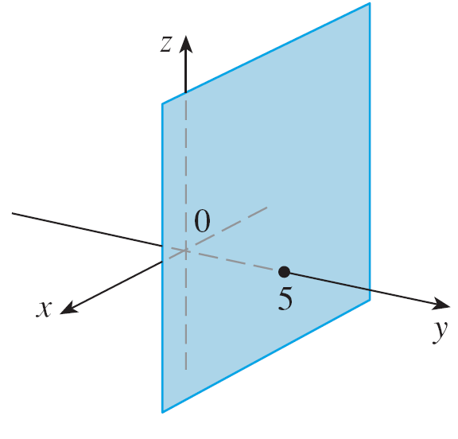
Example
What surfaces in are represented by the following equations?
(a) z = 3 (b) y = 5
Solution:
(A)
(B)

Slide 6
Formulas

Slide 7
Example
Find an equation of a sphere with radius r and center C(h, k, l ).
Solution:
| PC |² = r² or (x – h)² + (y – k)² + (z – l )² = r²
Figure 12

Slide 8

Vectors
Where A, B, C, and D are points in 3D space

Slide 9
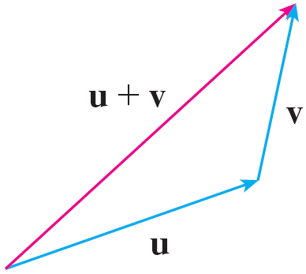
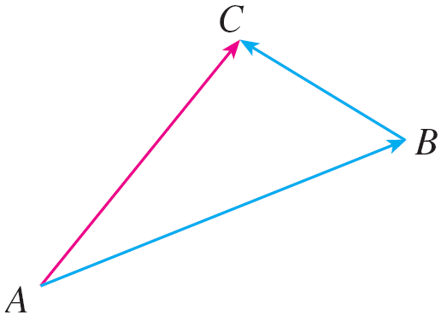

Vector Addition
Triangle Law
Head-to-tail
Completing the parallelogram, we see that u + v = v + u.
(Parallelogram Law)

Slide 10
Vector Addition

Slide 11
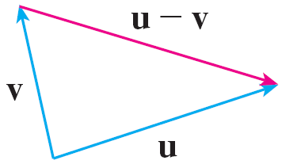
Vector Subtraction
Head-to-tail
-v
Tail-to-tail
Adding a negative vector

Slide 12
Example
Draw the sum of the vectors a and b
Solution:
Parallelogram Law

Slide 13
Scalar Multiplication

Slide 14
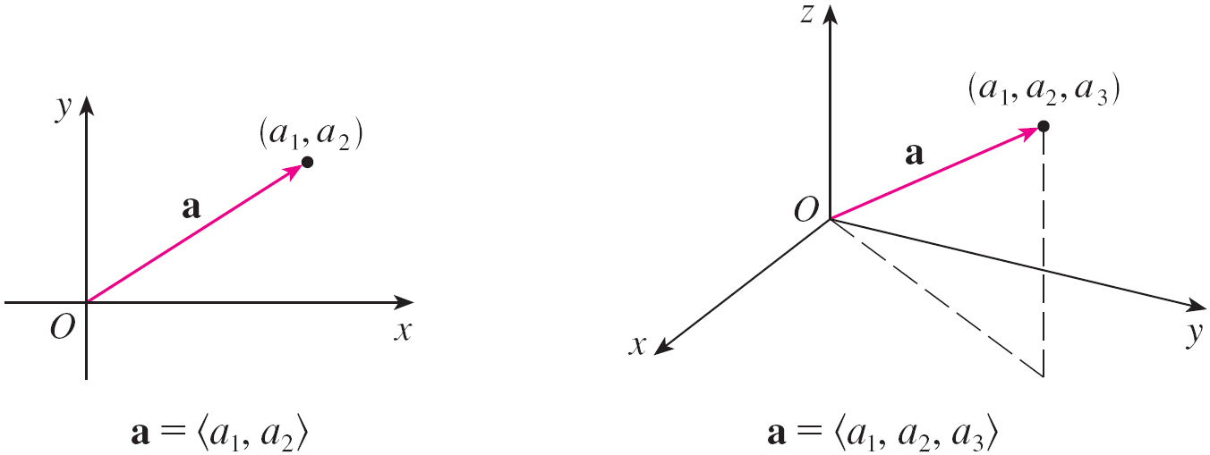
Extension to 3D
These coordinates are called the components of a

Slide 15
3D Vector

Slide 16
Vector Properties

Slide 17
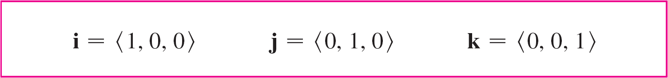
Common 3D Standard
a = a₁i + a₂ j + a₃k
vectors i, j, and k are called
the standard basis vectors
unit vector (u) length is 1

Slide 18
Example
A 100-lb weight hangs from two wires. Find the tensions (forces) T₁ and T₂ in both wires and the magnitudes of the tensions.

Slide 19
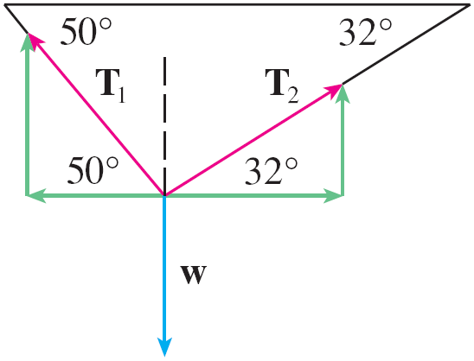
Example
We first express T₁ and T₂ in terms of their horizontal and vertical components. From Figure 20 we see that
T₁ = –| T₁ | cos 50° i + | T₁ | sin 50° j
T₂ = | T₂ | cos 32° i + | T₂ | sin 32° j
The resultant T₁ + T₂ of the tensions counterbalances the weight w and so we must have
T₁ + T₂ = –w = 100 j
Figure 20

Slide 20
Example – Solution
Thus (–| T₁ | cos 50° + | T₂ | cos 32°) I + (| T₁ | sin 50° + | T₂ | sin 32°) j = 100 j
Equating components, we get
–|T₁|cos 50° + |T₂| cos 32° = 0
|T₁|sin 50° + |T₂|sin 32° = 100
Solving the first of these equations for | T₂ | and substituting into the second, we get

Slide 21

Example – Solution
So the magnitudes of the tensions are
and
Substituting these values in and we obtain the tension vectors
T₁ ≈ –55.05i + 65.60j T₂ ≈ 55.05i + 34.40j

